Slide 1
Online Exam Registration System
Implemented By :
M Boopalan 17CSR020
K Hariprakash 17CSR055
L Gibson 17CSR040
P Gokulnath 17CSR043
OERS

Slide 2
PROBLEM STATEMENT
OERS
Applicants have to manually give their information by filling the Form of respective course.
Applicant may confuse what information & what type of form should be selected for a particular course.
Then the Exam Controller should verify and maintains large amount of paper works to issue their HallTicket.

Slide 3
PURPOSE
OERS
What information should be given are clear to the Applicants.
Information will be filled in a proper way.
Time complexity is reduced.
Reduces large paper works.
Increases the understanding of information for the Exam Controller.

Slide 4
SCENARIO
OERS
After login, the applicants can see the name of the examination, as they can simply apply by clicking on the name.
Their personal, qualification & exam particulars(INCLUDING FEE) are collected and stored in a database.
The Exam Controller verifies those details and the status of their application in informed instantly.
After successful verification, the Controller issue the HallTicket through any courier service.

Slide 5
PRODUCT PERSPECTIVE
OERS
System’s main perspective is to reduce the distance between applicants and the exam controller and to enhance the interaction between them
FUNCTION
Account registering using mail.
Complete filling details required for Exam registration process.
While filling instant validation of information.
After submition and successful verification, the mode of hallticket issue is announced

Slide 6
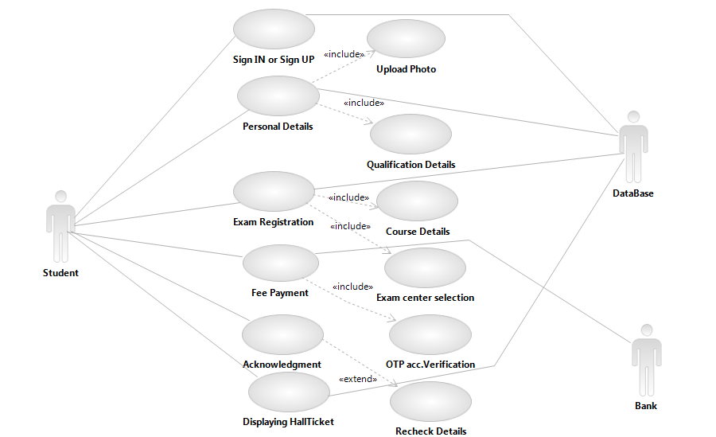
USE CASE DIAGRAM
OERS

Slide 7
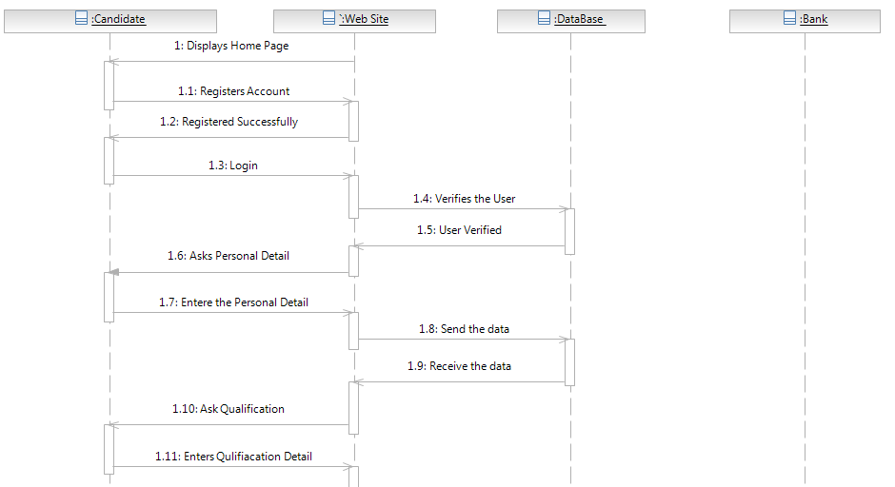
SEQUENCE DIAGRAM (Successful Registration)
OERS

Slide 8
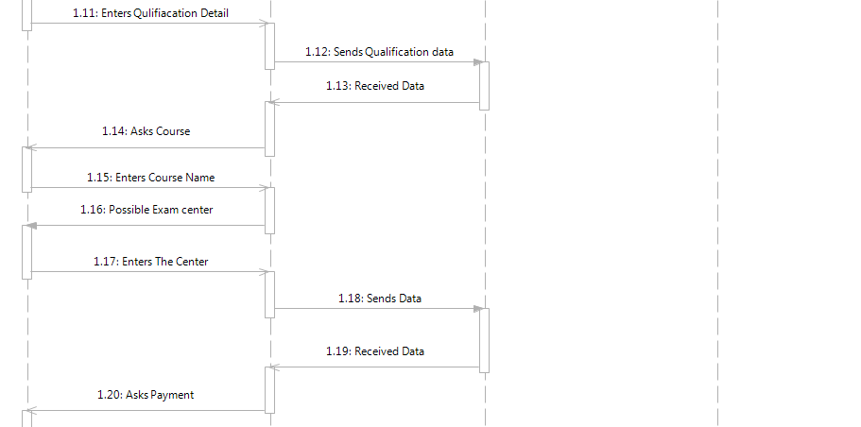
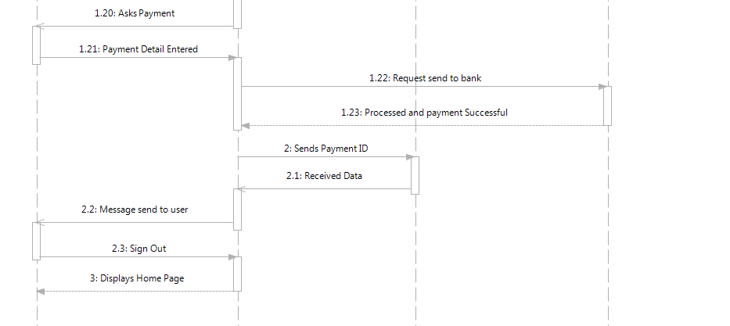

Slide 9
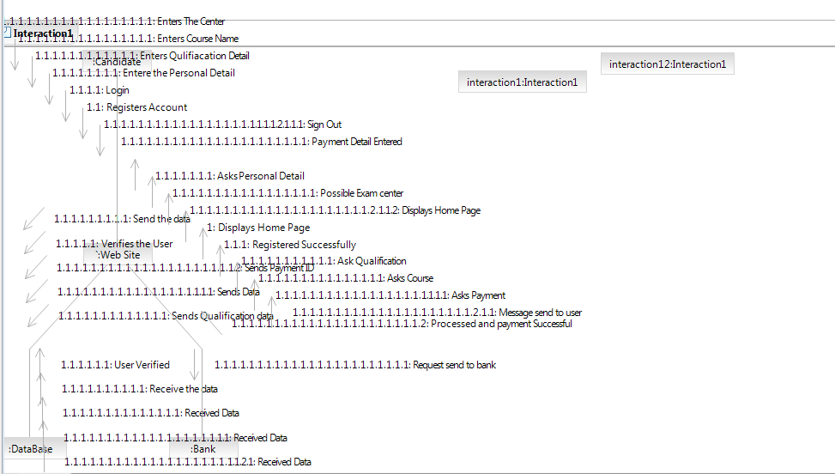
COLLABORATION DIAGRAM
OERS

Slide 10
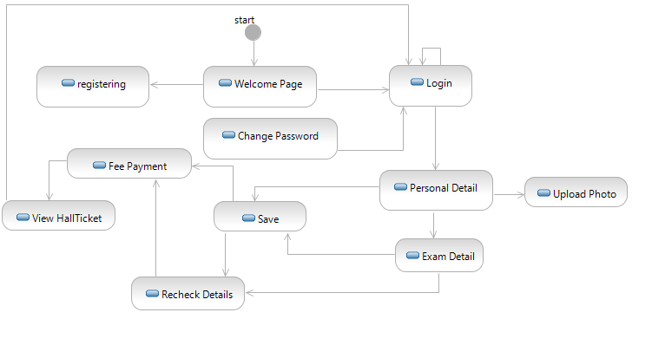
STATE DIAGRAM
OERS

Slide 11
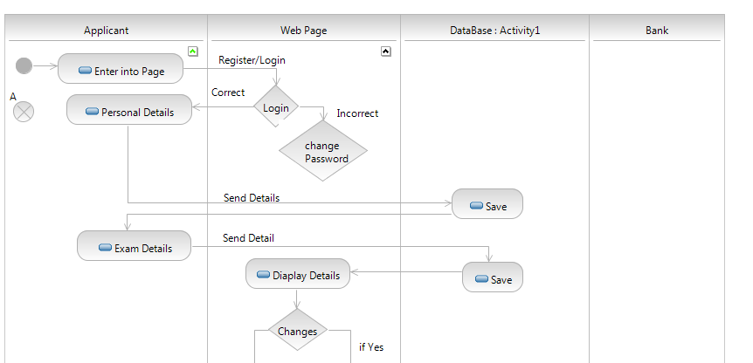
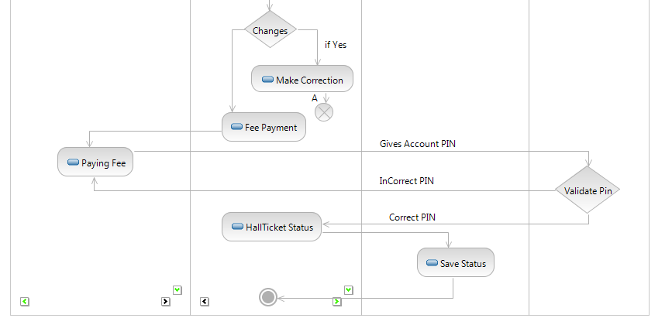
ACTIVITY DIAGRAM (Successful REgistration)
OERS
OERS

Slide 12
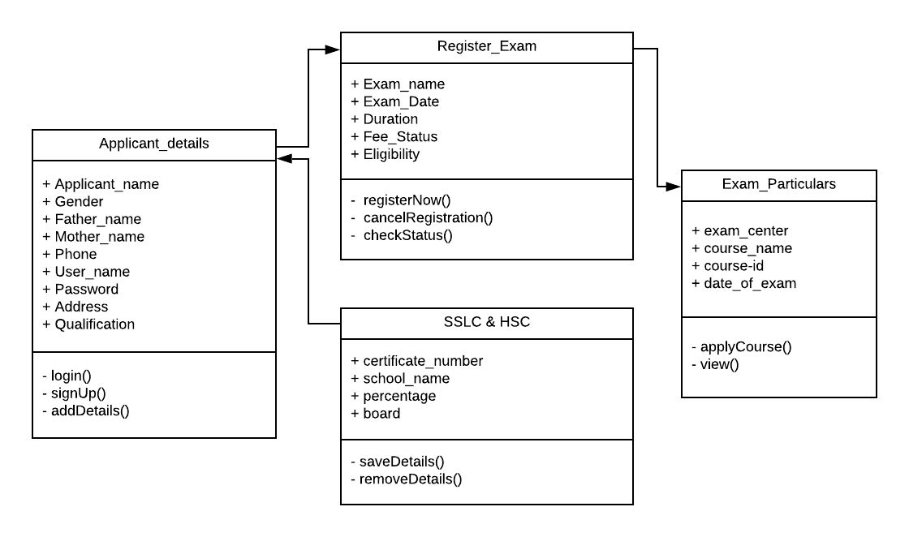
CLASS DIAGRAM
OERS

Slide 13
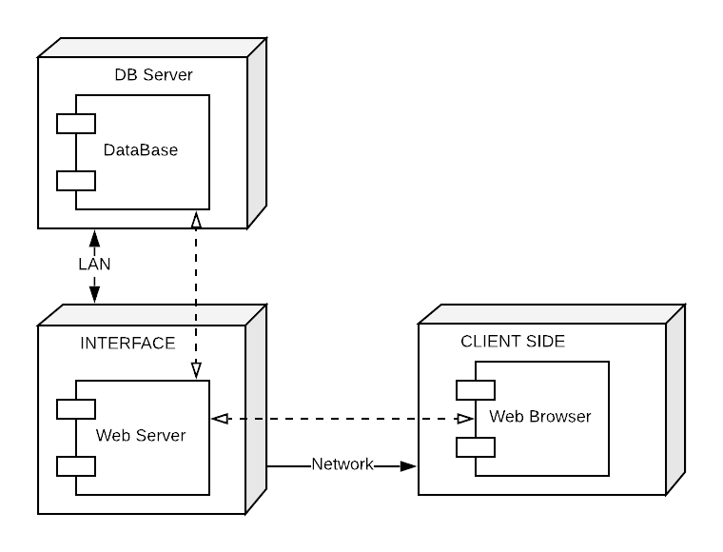
COMPONENT DIAGRAM
OERS

Slide 14
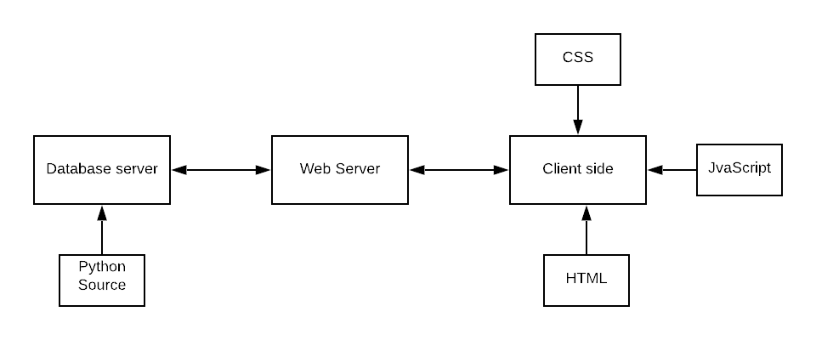
DEPLOYMENT DIAGRAM
OERS

Slide 15

IMPLEMENTATION SCREENSHOTS
OERS
Sign Up Now

Slide 16
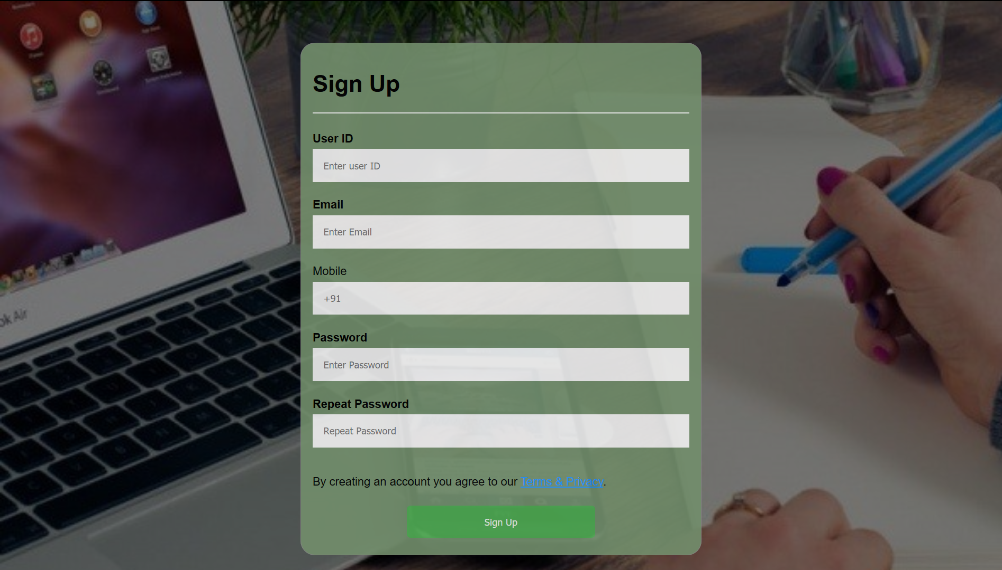
OERS
Sign Up Now
Sign Up Now

Slide 17
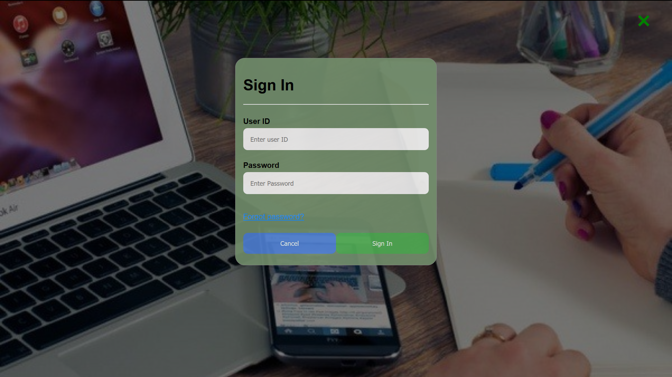
OERS
Sign In

Slide 18
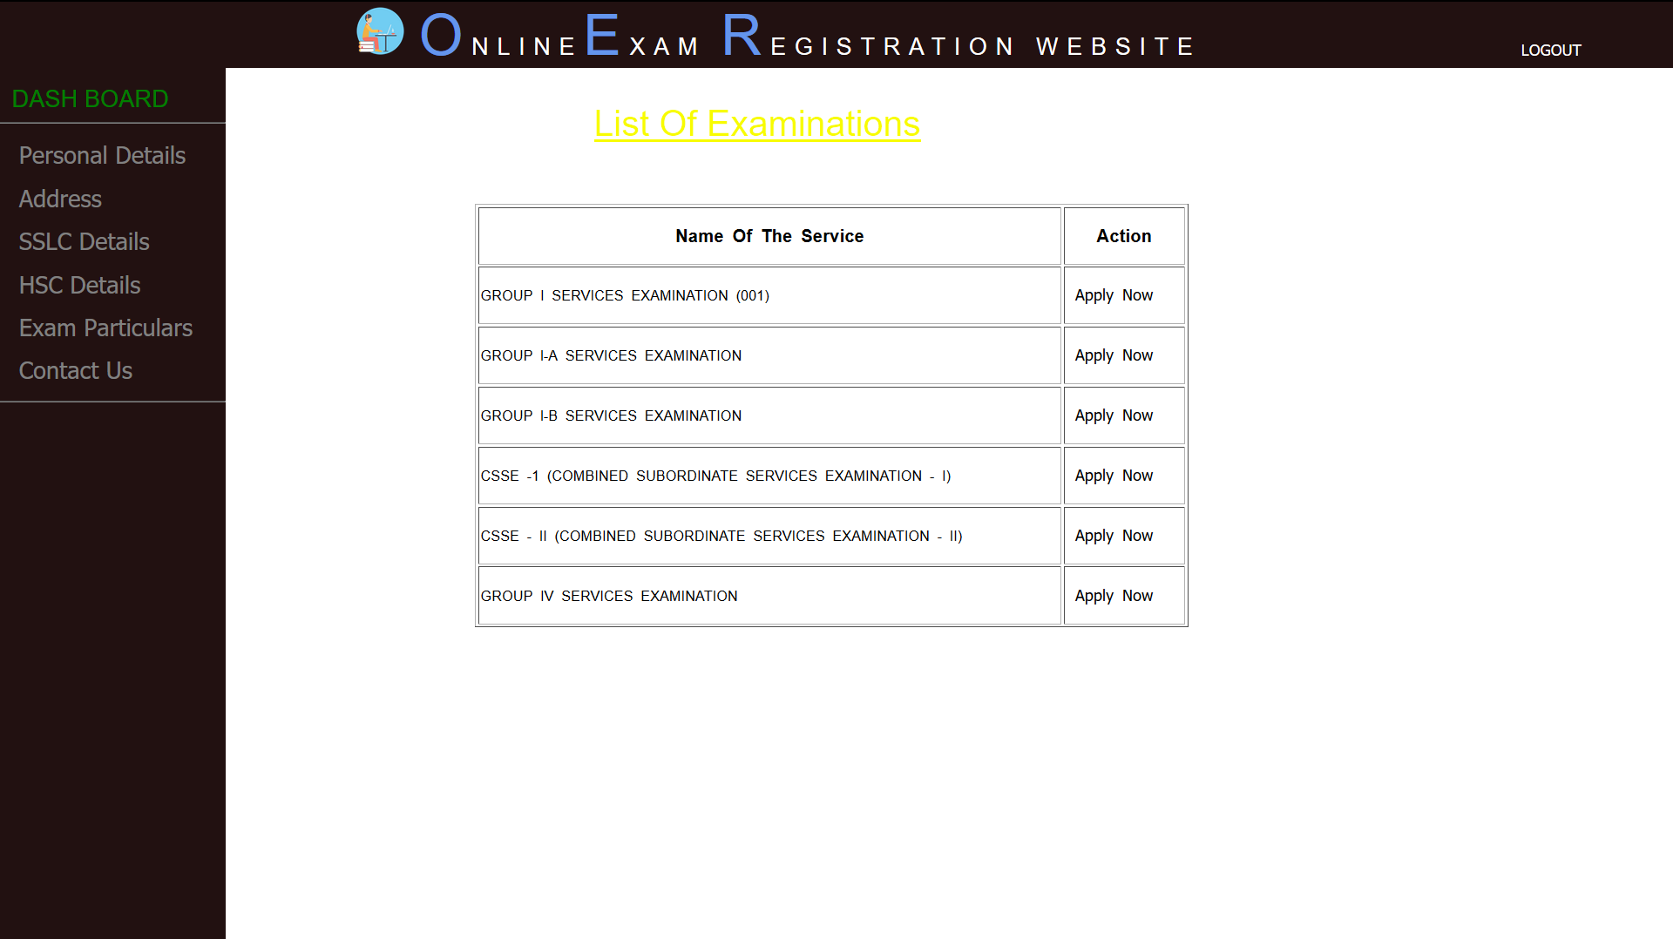
OERS
Home Page

Slide 19
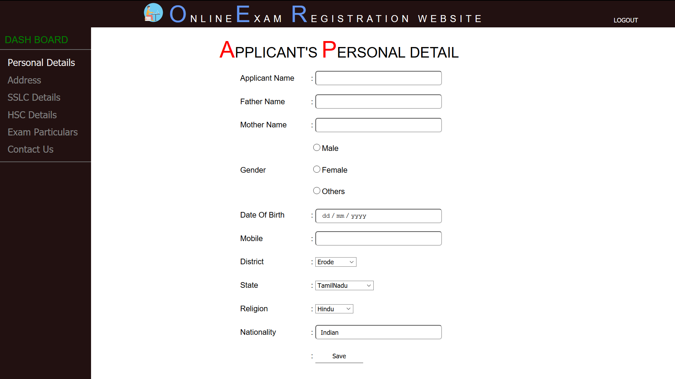
OERS
Personal Tab

Slide 20
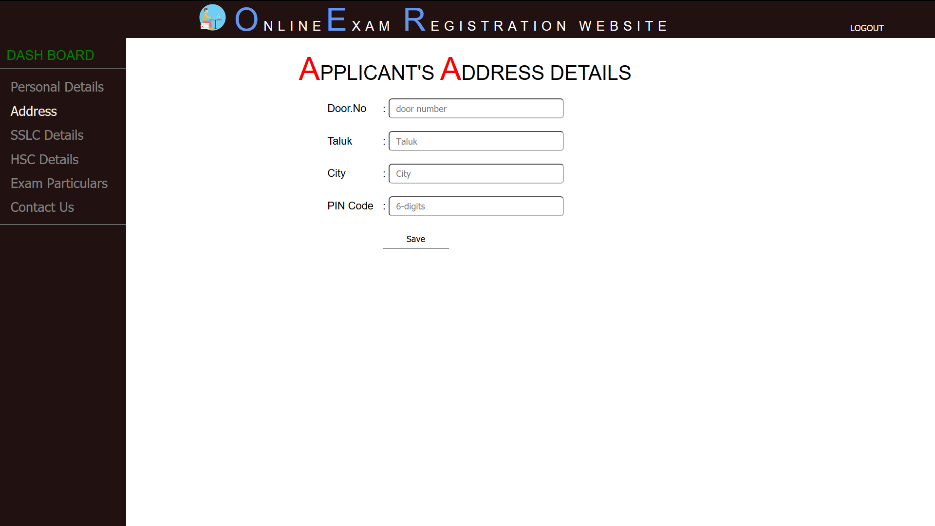
OERS
Address Tab

Slide 21

OERS
SSLC Tab

Slide 22

OERS
HSC Tab

Slide 23
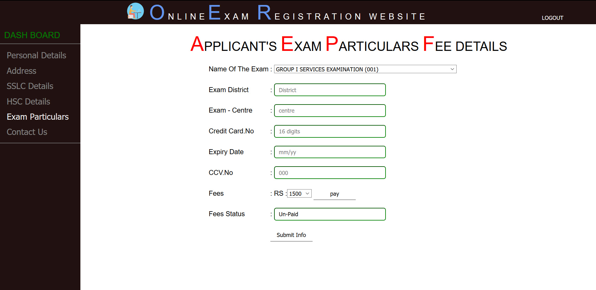
OERS
Exam Particulars

Slide 24
THANK YOU
OERS

